Slide 1
Basic ORM Mapping
&
CRUD operations

Slide 2
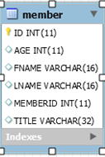
How to Get
From Here To Here
public class Member {
private long id;
private String firstName;
private String lastName;
private int age;
private String title;
private int memberNumber;

Slide 3
Basic Class to Database Table
Mapping
Use a Domain Class POJO
Mutators & Accessors [getters/setters]
Default Constructor
Annotate the Domain Class
@Entity declares a class as a persistent class
@Table identifies the RDB table name
@Id declares the identifier property of the entity.
@Id on field means field annotations
@Id on setter means property annotations
Entities instantiated using Reflection API Constructor.newInstance()
Default: class name of the entity
For ID - use a nullable (i.e., non-primitive) type.
Notes:
override the equals() and hashCode() methods if you:
intend to put instances of persistent classes in a Set (the recommended way to represent many-valued associations); and
intend to use reattachment of detached instances
For ID - use a nullable (i.e., non-primitive) type. -- new entity has null ID !!!!
Access type : defines how to access data ---from DB
property or field
The problem with the property access is that the setters are also called when the object is loaded.
If your SET method has business logic, it will be called when you programmatically call SET &
Will be called AGAIN by Hibernate when you load the object…
Best Practices
There is not much of difference between the field and property level access with respect to performance.
Field level access would be preferred if the code avoids hibernate proxy pitfalls!If there is a need for property access later, this can always be supported by adding the necessary accessors!
Field level access proves to be good if you really want the annotations closer to the code. This not only gives a fare idea of the property details but also avoids unnecessary accessors that might prove to be great evil.
Property level access can be implemented as long as you do not have business logic or validations within your domain objects since one such scenario can prove to be very dangerous!

Slide 4
@Id Annotation
Identifier Generation Strategy
@GeneratedValue(strategy=GenerationType.AUTO)
Generating the identifier property:
AUTO either identity, sequence or table depending on the
underlying DB
TABLE Special table holds the id
IDENTITY Identity column […in entity table]
DB provides facility to generate ID value during insertion
SEQUENCE
DB has facility to create a special/custom sequence
generator
AUTO is the preferred type for portability (across DB vendors).
For MySQL AUTO preferred type is IDENTITY
Which looks like this:
ID INT PRIMARY KEY AUTO_INCREMENT
Notes:
HIBERNATE TABLE == two columns: the entity name, and the max identity already assigned to this entity
IDENTITY == The IDENTITY generator allows an integer/bigint column to be auto-incremented on demand.
CREATE SEQUENCE APP_USERS_SEQ START WITH 200 INCREMENT BY 10 NOCACHE NOCYCLE;
@SequenceGenerator( name = "appUsersSeq", sequenceName = "APP_USERS_SEQ", allocationSize = 10, initialValue = 200 )
@GeneratedValue( strategy = GenerationType.SEQUENCE, generator = "appUsersSeq" )
allocationSize = 10 how many to fetch - keep in pool for usage [if =10, will get 10(should be same as increment) then allocate as needed]
want the sequence to start from 2000 and the allocation size is 10 - mark the seq in the DB as starting from 200

Slide 5
MySQL GenerationType.AUTO with Hibernate 5
Uses GenerationType.TABLE NOT GenerationType.IDENTITY
Table has performance and scalability issues
SOLUTION:
@GeneratedValue(strategy= GenerationType.IDENTITY)
OR
@GeneratedValue(strategy=GenerationType.AUTO,generator="native")
@GenericGenerator(name = "native", strategy = "native")
NOTE:
strategy = "native" - selects identity, sequence or hilo depending upon the capabilities of the underlying database.
Notes:
Hib 5 want SEQUENCE not directly supported in MySQL…simulate with TABLE
NATIVE - selects identity, sequence or hilo depending upon the capabilities of the underlying database.

Slide 6
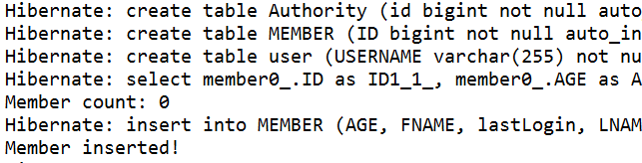
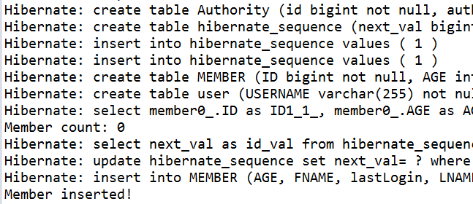
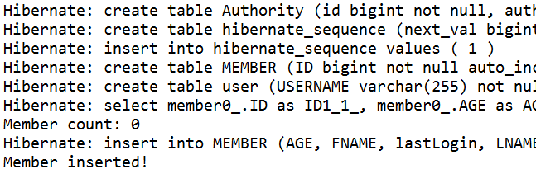
MySQL GenerationType Performance
Hibernate 4 AUTO
Hibernate 5 IDENTITY
-----------------------------------------------------------------
Hibernate 5 AUTO
--------------------------------------------------------------------------------------------------
Hibernate 5 native
Notes:
Database sequences are the best identifier generator choice when using JPA and Hibernate. This is because, unlike IDENTITY generator, you can take advantage of JDBC batch updates. Therefore, you should always use a database sequence if the underlying database supports this feature.
SEE: https://vladmihalcea.com/hibernate-identity-sequence-and-table-sequence-generator/

Slide 7
@Column Annotation
@Column is optional
@Column(
name="columnName";
boolean unique() default false;
boolean nullable() default true;
boolean insertable() default true;
boolean updatable() default true;
String columnDefinition() default ""; //SQL to generate column
String table() default "";
int length() default 255; // String
int precision() default 0; // Decimal precision
int scale() default 0; // Decimal scale
Default: field name
columnDefinition=“Decimal(10,2) NOT NULL UNIQUE"
Notes:
https://docs.jboss.org/hibernate/stable/annotations/reference/en/html/entity.html#entity-mapping
columnDefinition - SQL fragment that is used when generating column --- Decimal(10,2) instead of precision(10) & scale(2)
Upto 10 digits – 2 are decimal values 12345678.12

Slide 8
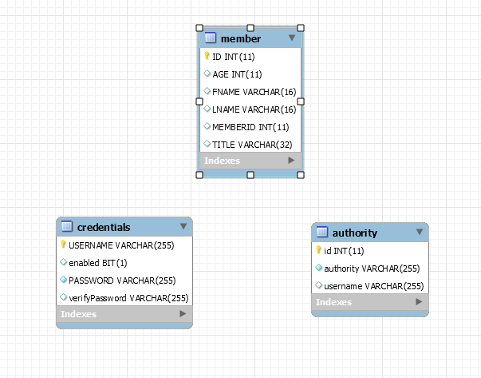
Class to Table Mapping
Examples
Generated Tables
Java - JDBC types
See Basic Mapping Demo
Notes:
https://db.apache.org/ojb/docu/guides/jdbc-types.html

Slide 9
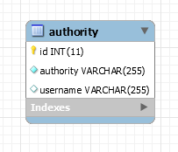

Authority Example
Table = Class ; lower case first letter
Field name = column name
String default 255
@Entity
public class Authority {
@Id
@GeneratedValue(strategy=GenerationType.AUTO)
private Integer id;
private String username;
@Column(nullable = false)
private String authority;

Slide 10
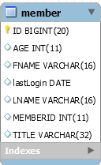
Member Example
@Entity(name = "MEMBER")
public class Member {
@Id
@GeneratedValue(strategy=GenerationType.AUTO)
@Column(name="ID")
private Long id;
@Column(name="FNAME", length = 16)
private String firstName;
@Column(name="LNAME", length = 16)
private String lastName;
@Column(name="AGE")
private int age;
@Column(name="TITLE", length = 32)
private String title;
@Column(name="MEMBERID")
private int memberNumber;
@Temporal(TemporalType.DATE)
@Column
private Date lastLogin;
Long == BigInt
TABLE = Entity name
Explicit String length
Field name= Declared name

Slide 11
@Temporal
@Temporal converts date and time values from Java object to compatible database type and retrieving back to the application.
java.util.Date or java.util.Calendar require @Temporal to map to database types
Not required when using java.sql.Date or java.sql.Time
]
@Temporal(TemporalType.DATE) Same as:
private java.util.Date lastLogin; java.sql.Date lastLogin;
@Temporal(TemporalType.TIME) Same as:
private java.util.Date lastLogin; java.sql.Time lastLogin;
@Temporal(TemporalType.TIMESTAMP) Same as:
private java.util.Date lastLogin; java.sql.Timestamp lastLogin;
WITHOUT @Temporal Same as:
private java.util.Date lastLogin; java.sql.Timestamp lastLogin;
Notes:
DATE = date
TIME = hour min sec
TIMESTAMP = DATE + TIME
WITHOUT @Temporal will store TIMESTAMP:
private Date joinedDate;the stored value looks like 08-07-17 04:33:35.870000000 PM
http://www.objectdb.com/api/java/jpa/Basic
FetchType fetch
boolean optional
The use of the Basic annotation is optional for persistent fields and properties of these types. If the Basic annotation is not specified for such a field or property, the default values of the Basic annotation will apply. [ USED for Java Primitives]

Slide 12

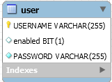
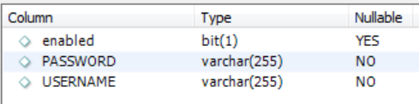
UserCredentials
Example
Entity/Table name different from Class name
ID – String - USERNAME - unique
Password not NULL
@Entity(name = “USER")
public class UserCredentials {
@Id
@Column(name = "USERNAME", nullable = false, unique = true)
String username;
@Column(name = "PASSWORD", nullable = false)
String password;
@Transient
String verifyPassword;
Boolean enabled;
@Column annotation can be optional

Slide 13
Main Point
The mapping of simple object structures to a database is done through configuration files and/or annotations. This simple configuration is enough to instruct the framework about the objects it has to control and store.
Science of Consciousness: The simple mechanics of the TM technique allow [instruct] the mind to transcend to the home [store] of all knowledge.

Slide 14
CRUD Services
Core J2EE DAO pattern
Data Access Object (DAO)
Manage the connection with the data source
Abstract and encapsulate access to data source
Provides CRUD access:
Create
Read
Update
Delete
Hides the data source implementation details
Interface allows for different storage schemes
Adapter between the client and the data source.

Slide 15
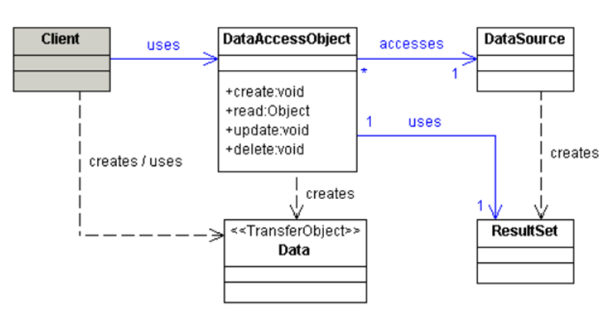
DAO Interactions

Slide 16
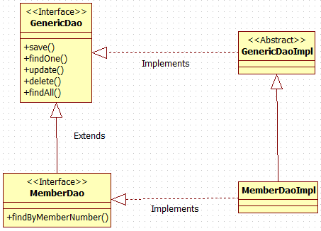
“Classic” ORM GenericDAO
Generic types
Adds Domain Object specific functionality

Slide 17
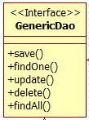
Generic DAO Interface
public interface GenericDao<T> {
void save(T t);
void delete(Long id);
T findOne(Long id);
T update(T t);
List<T> findAll();

Slide 18
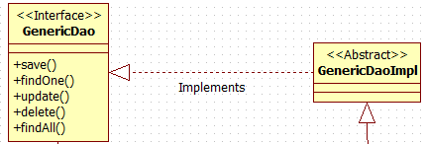
Generic DAO Implementation
public abstract class GenericDaoImpl<T> implements GenericDao<T> {
@PersistenceContext
protected EntityManager entityManager;
protected Class<T> daoType;
public void setDaoType(Class<T> type) {
daoType = type;
}
@Override
public void save( T entity ){
entityManager.persist( entity );
}
public void delete( T entity ){
entityManager.remove( entity );
}
@Override
public void delete(Long id) {
T entity = findOne( id );
delete( entity );
}
@Override
public T findOne( Long id ){
return (T) entityManager.find( daoType, id );
}
@SuppressWarnings("unchecked")
@Override
public List<T> findAll(){
return entityManager.createQuery( "from " + daoType.getName() )
.getResultList();
}
@Override
public T update( T entity ){
return entityManager.merge( entity );
}
JPA implementation uses EntityManager
Hiberate implementation uses SessionFactory
@Autowired
protected SessionFactory sessionFactory;

Slide 19
Domain Class specific DAO
public interface MemberDao extends GenericDao<Member> {
public Member findByMemberNumber(Integer number);
public class MemberDaoImpl extends GenericDaoImpl<Member> implements MemberDao
public MemberDaoImpl() {
super.setDaoType(Member.class);
}
public Member findByMemberNumber(Integer number) {
Query query = entityManager.createQuery("select m from MEMBER m
where m.memberNumber =:number");
return (Member) query.setParameter("number", number).getSingleResult();
}

Slide 20
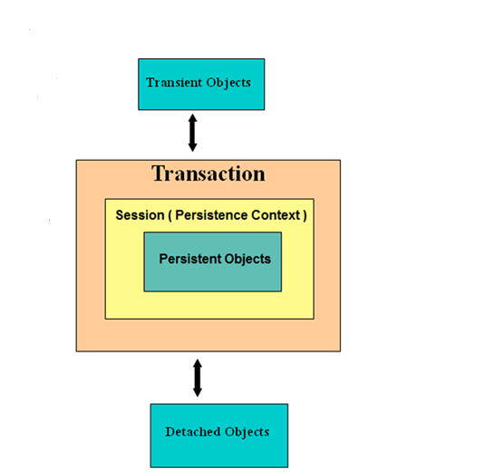
ORM – RDB Interactions
Transaction
Logical unit of work
One or more DB queries
Atomic [ All or None]
Persistence Context
Establishes DB connection
Holds DB-aware objects

Slide 21

ORM Persistence Context
Persistence Context ~= Hibernate Session
Persistence Context [session]
Spring “manages” through @Transactional
Transaction Unit of work
Common Pattern: session-per-request
Persistence Context == Database Transaction
START –
Open a Persistence Context
Open a single database connection
Start a Transaction
Associate & Manage entities W/R the Persistence Context
Exercise DB CRUD operations
END –
End Transaction
Close a Persistence Context
@Service
@Transactional
public class ProductServiceImpl implements ProductService{
public Product getProductById(Long productID) {
return productDao.findOne(productID);
}
Open PersistenceContext/Start Transaction when method is called
End Transaction/ Close PesistenceContext when method is exited
Notes:
session-per-request-with-detached-objects

Slide 22
ORM-related Entity States
Transient –
it has just been instantiated using the new operator
not associated with a Persistence Context
no persistent representation in the database
Persistent –
representation in the database
Has been saved or loaded in Persistence Context
Changes made to an object are synchronized with the database when the unit of work completes..
Detached –
Object was persistent, but Persistence Context has been closed
Removed –
An object is deleted from the database when the unit of work completes

Slide 23
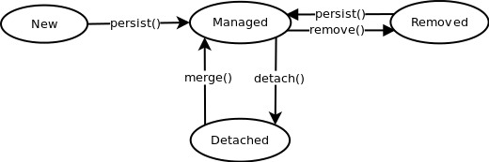
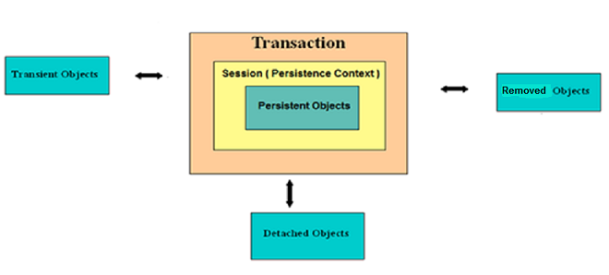
ORM Entity Lifecycle
Transient Persistent Removed
Detached

Slide 24
ORM caching mechanisms
Persistence provider manages local store of entity data
Leverages performance by avoiding expensive database calls
CRUD operation can be performed through normal entity manager functions
Application can remain oblivious of the underlying cache and do its job without concern
Level 1 Cache
Available within the same transaction [Persistence Context]
Level 2 Cache
Available throughout the application.
first level cache CRUD operations are performed per transaction basis to reduce the number of queries fired to the database. That is, an entity modified several times within the same transaction is done in the cache only, modification at the database level is slated until final UPDATE statement is fired at the end of the transaction.

Slide 25
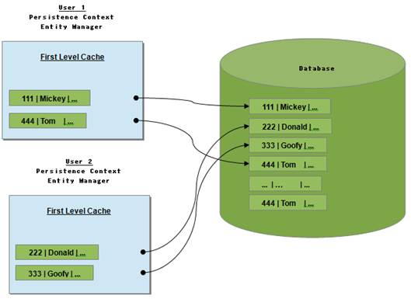
Level 1 Cache

Slide 26
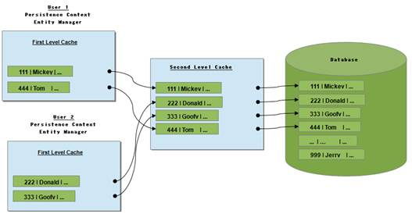
Level 2 Cache

Slide 27
Managing the CRUD operations
CRUD JPA
Create Persist
Read Find
Update Merge
Delete Remove
Flush
Refresh

Slide 28
Create == Persist
Same as Hibernate session.persist()
Does not create SQL insert statement immediately
The commit of the transaction sends insert to DB
EFFICIENT
If you change multiple fields, add a relation while an entity is in managed state, only one update statement at the end.
Minimum row lock time
Hibernate save – insert immediately less efficient
JPA has no such method
Hibernate saveOrupdate -- attaches the passed entity to the persistence context
ISSUE: If entity ALREADY in persistence context with the same ID,
a NonUniqueObjectException is thrown.
JPA has no such method

Slide 29
READ == FIND
Object fetch [ through Level 1 cache]
That is, if Object is in cache return that value,
if NOT in cache, fetch Object from DB
entityManager.findOne(Member.class,memberId);
Hibernate get() identical to JPA find
Notes:
Hibernate community says that working outside of transaction might cause unpredictable behavior. This is because Hibernate will open transaction, but it won't close it on its own, thus connection will be returned to the Connection Pool with transaction being not committed.
read-only transactions can be optimized by DBs, but this of course is DB specific. E.g. MySQL added support for this only in InnoDB starting from 5.6.4 version.

Slide 30
READ [Lazy] == getReference()
Doesn’t load the full object state - just gets a reference to it
Only fetches from DB when an object field is referenced.
NOTE: Reference MUST be done in the PersistenceContext
User user = new User();
user.SetName("Henry");
Member member=
entityManager.getReference(Member.class, Id);
user.setMember(member);
em.persist(user);
Similar to Hibernate load()
no query to the DB
Notes:
Uses proxy object.
public class PersonProxy {
// JPA provider sets up this field when you call getReference
private Integer personId;
private String query = "UPDATE PERSON SET ";
private boolean stateChanged = false;
public void setAge(Integer newAge) {
stateChanged = true;
query += query + "AGE = " + newAge;
}
}

Slide 31
Update == Merge
Entity is in Detached state
ORM fetches the ”current” entity from the database.
ORM copies values of detached object to the fetched object
The fetched object is THE managed object
The detached object is NOT a managed object.
Return/ operate on the fetched object.
Member fetchedMember =
entityManager.merge(detachedMember);
NOTE: Calling MERGE on a TRANSIENT object will PERSIST it..
Hibernate has update which attaches the passed entity to the persistence context
ISSUE: If entity ALREADY in persistence context with the same ID,
a NonUniqueObjectException is thrown.
JPA has no such method
Notes:
Notice merge() has a return value? That's because it returns you the managed graph, which may not be the graph you passed it. merge() is a JPA API and its behavior is governed by the JPA spec. If the object you pass in to merge() is already managed (already associated with the Session) then that's the graph Hibernate works with; the object passed in is the same object returned from merge(). If, however, the object you pass into merge() is detached, Hibernate creates a new object graph that is managed and it copies the state from your detached graph onto the new managed graph. Again, this is all dictated and governed by the JPA spec.

Slide 32
Update a managed object
Results in a Implicit save/merge….at commit…
Open Session/Start Transaction
Member member = entityManager.find(Member.class, 4711);
member.setName(“Frank Lee");
End Transaction/Close Session
Member is UPDATED with name = “Frank Lee” in DB

Slide 33
Delete = Remove
Need to Make entity managed[merge] BEFORE delete
Member mergedMember = entityManager.merge(member);
entityManager.remove(mergedMember);
A detached entity is possibly stale. You need to “synchronize” [merge] it with the DB before removing…
Notes:
Hibernate delete will delete WITHOUT first making the object managed…
ISSUE : doesn’t remove the associated instances…
Since ‘17’ could be associated with other entities – falls over…
Contact contact = new Contact();
contact.setId(17);
session.delete(contact );
To be able to know which associated entities to remove, the entity manager can't rely on a detached entity, since, by definition, this detached entity doesn't reflect the latest state of the entity, and doesn't necessarily have all its cascaded associations recursively loaded.

Slide 34
Flush
Flush() sends SQL instructions to the database
[e.g.,INSERT, UPDATE ]
Synchronizes the managed objects with the database
FlushMode default is AUTO
[AUTO] Flush occurs :
Before query execution
Transaction commit
EntityManager.flush() is explicitly called
EntityManager.setFlushMode(FlushModeType.COMMIT)
disables flush before query execution {#1 above}

Slide 35
Refresh
Refresh will reread the object from the database.
USE CASE:
Database triggers are used to initialize some of the properties of the entity
…Can also be used to undo updates
em.persist(member);
em.flush(); // force the SQL insert and triggers to run
em.refresh(member);

Slide 36
Main Point
The persistence framework has a set of simple common operations . We simply configure and use them improving flexibility, overall accuracy and performance of the system.
Science of Consciousness: Research found that participants in the Transcendental Meditation program showed greater activation of the appropriate hemisphere of the brain. This means the brain responds more flexibly and dynamically.

